Slide 1
Deep Learning Concepts
A One-Day Bootcamp Focused on Concepts and Examples

Slide 2
Goals
Some Intuitive Understanding of Deep Learning
Examples:
Regression
Hand-written Digits
Movie Review Sentiment: Text
Cats/Dog Images
Using Google Colab

Slide 3
Google Colab
colab.research.google.com
Free platform for Python Notebooks
Access to a free GPU (faster computation for Deep Learning)

Slide 4

Notes:
If you’re doing the work, it’s ML. If presenting, it’s AI

Slide 5
Reminder: Linear Regression
spend | revenue
$ 42.61 | $ 354.68
$ 91.14 | $ 534.16
$ 36.34 | $ 279.96
$ 38.78 | $ 81.12
$ 81.28 | $ 469.40
$ 48.16 | $ 245.52
$ 85.14 | $ 410.88
$ 1.12 | $ 17.44
$ 55.63 | $ 309.12
$ 33.05 | $ 204.36
Notes:
If Ad Spend = $70, then Revenue = $389.48
Guess. Look at the Revenue around 40. Goes Up, then down, then up then down, then up. Why?
You’ve just used a model to make a prediction.

Slide 6
Neural Network
SHOW ANDREW NG VIDEO

Slide 7
Neural Network
Price:
Shipping Cost:
Marketing:
Material:
20
5
2 (= Online)
1 (= Cotton)
Affordability
Awareness
Quality
Demand

Slide 8
(.1) * 20 + (.33) * 6 + (2) = 6
Price:
Shipping Cost:
Marketing:
Material:
20
6
2 (= Online)
1 (= Cotton)
6
Affordability
Awareness
Quality
Demand: 90

Slide 9
(.8) * 2 + (1) = 2.6
Price:
Shipping Cost:
Marketing:
Material:
20
6
2 (= Online)
1 (= Cotton)
6
Affordability
Awareness
Quality
Demand: 90
2.6

Slide 10
(.5) * 20 + (.1) * 2 + (.7) * 1 + (1) = 11.9
Price:
Shipping Cost:
Marketing:
Material:
20
6
2 (= Online)
1 (= Cotton)
6
Affordability
Awareness
Quality
Demand: 90
2.6
11.9

Slide 11
(.2) * 6 + (.9) * 2.6 + (.6) * 11.9 + (5) = 15.68
Price:
Shipping Cost:
Marketing:
Material:
20
6
2 (= Online)
1 (= Cotton)
6
Affordability
Awareness
Quality
Demand: 90
2.6
15.7
11.9
15.7 is NOT close to 90!
The weights and biases (red numbers) need to change.

Slide 12
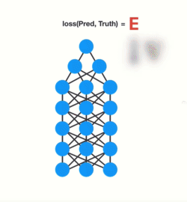
What is the “Learning” Part?
Neural Networks learn through Backpropagation
This tells the network how to nudge or adjust the weights to improve predictions.

Slide 13
Other Algorithms
K-Nearest Neighbor
Linear Regression
Decision Trees
Random Forests
Gradient Boosting Machines
What make Deep Learning different?

Slide 14

https://towardsdatascience.com/cnn-application-on-structured-data-automated-feature-extraction-8f2cd28d9a7e

Slide 15
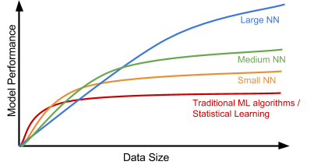


Why Popular Now?
Andrew Ng, deeplearning.ai

Slide 16
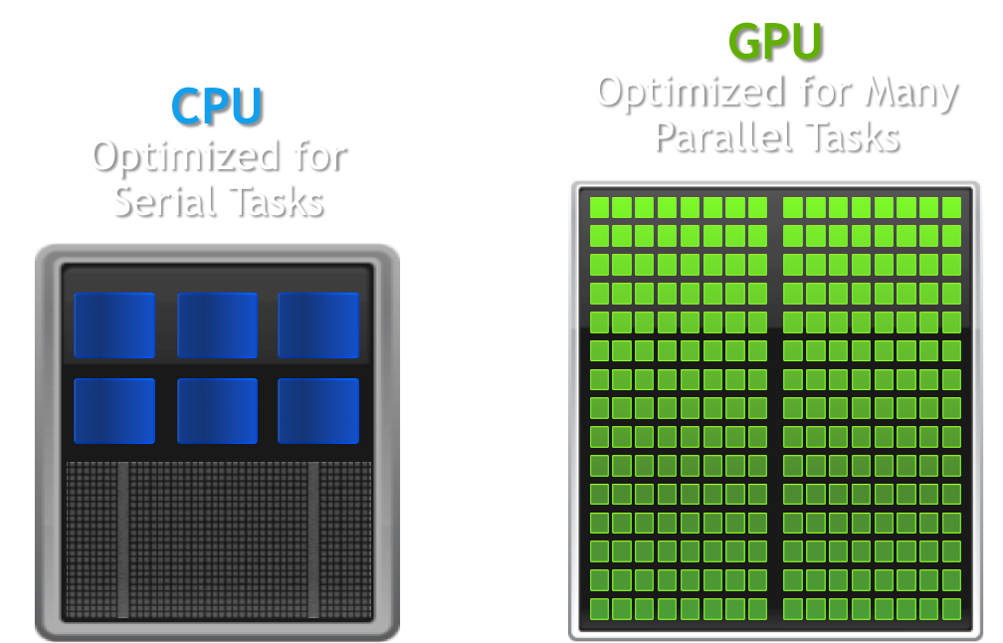
Why So Popular Now
Hardware: GPU
Research: New Methods
Investments

Slide 17
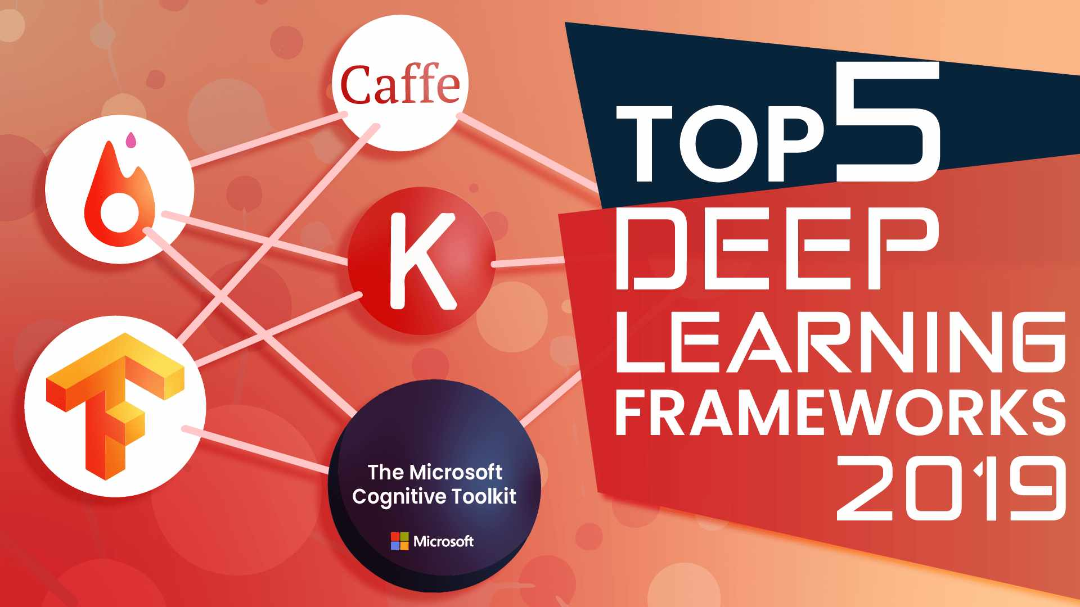
Deep Learning Frameworks
We will use Keras, which makes using TensorFlow easier.
Tensorflow, Pytorch, Keras, Microsofts, others….

Slide 18
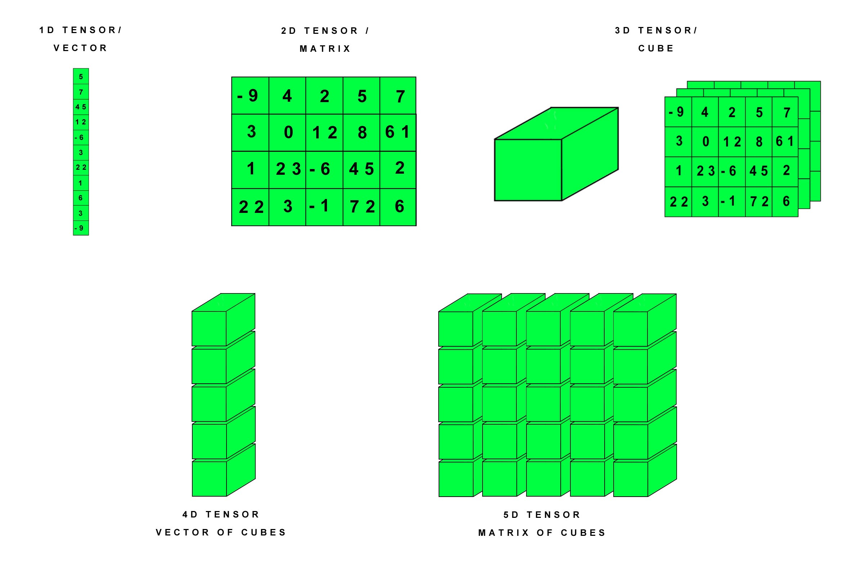
Tensors
https://hackernoon.com/learning-ai-if-you-suck-at-math-p4-tensors-illustrated-with-cats-27f0002c9b32

Slide 19
Per capita crime rate.
Proportion of residential land.
Proportion of non-retail business.
Charles River dummy.
Nitric oxides concentration.
Average number of rooms per dwelling.
Proportion of units built prior to 1940.
Distances to employment centres.
Index of accessibility to radial highways.
Full-value property-tax rate per $10,000.
Pupil-teacher ratio by town.
proportion of Black people by town.
% lower status of the population.
Price

Slide 20
1.
Per capita crime rate.
Proportion of residential land.
Proportion of non-retail business.
Charles River dummy.
Nitric oxides concentration.
Average number of rooms per dwelling.
Proportion of units built prior to 1940.
Distances to employment centres.
Index of accessibility to radial highways.
Full-value property-tax rate per $10,000.
Pupil-teacher ratio by town.
proportion of Black people by town.
% lower status of the population.
…
32.
Price
64 nodes
…
64.

Slide 21
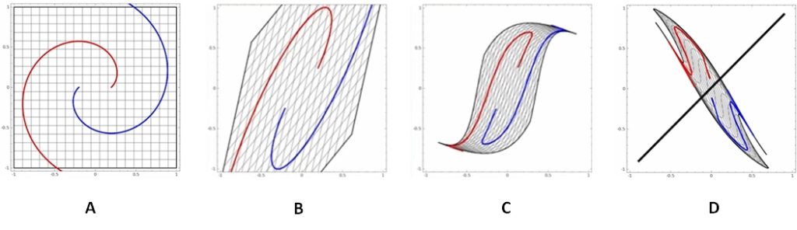
Simple Representation Change
https://machinelearning.technicacuriosa.com/2017/03/19/a-darpa-perspective-on-artificial-intelligence/

Slide 22
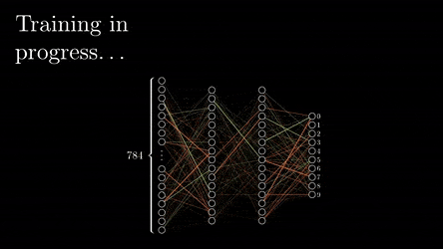
A Deeper Neural Network

Slide 23
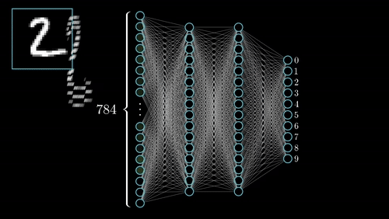
A Deeper Neural Network

Slide 24
Core Pieces of Network Code
Notes:
Deep Learning with Python, page 32

Slide 25
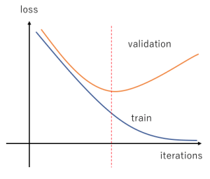
Overfitting vs. Underfitting
Overfitting: Memorizing the training data. Model won’t do well on data it has not seen.
Underfitting: Not learning enough patterns in the training data.

Slide 26
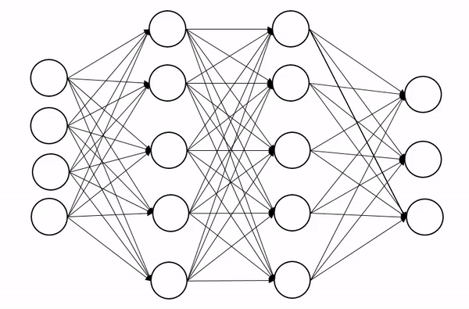
Regularization
Regularization = fighting overfitting
If network can only memorize a small number of patterns, the optimization process will force it to learn prominent patterns.
Notes:
https://www.globalsoftwaresupport.com/regularization-machine-learning/

Slide 27
Deep Learning in Computer Vision
Using “convnets” or convolutional neural networks

Slide 28
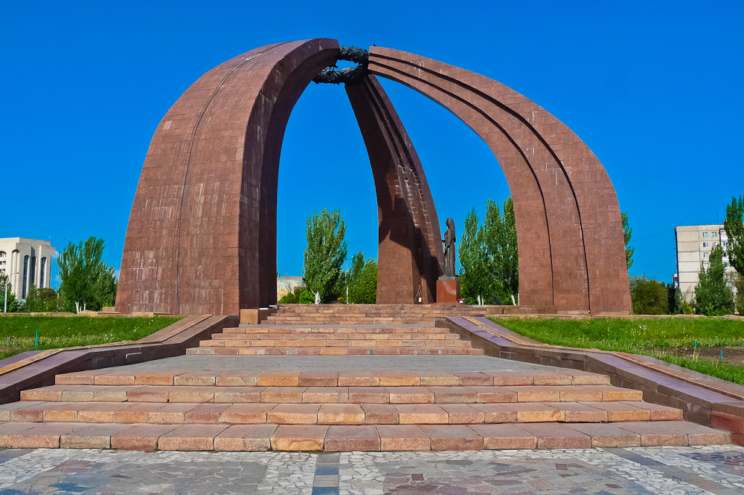
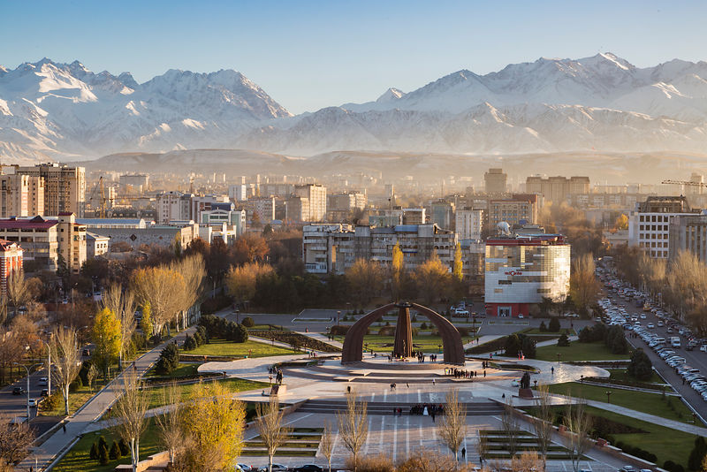
Convolution
Learn Local Patterns
Translation Invariant

Slide 29
Spatial Hierarchy

Slide 30
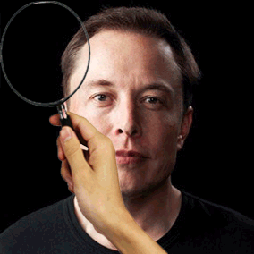

Convolution
Notes:
https://towardsdatascience.com/cutting-edge-face-recognition-is-complicated-these-spreadsheets-make-it-easier-e7864dbf0e1a

Slide 31
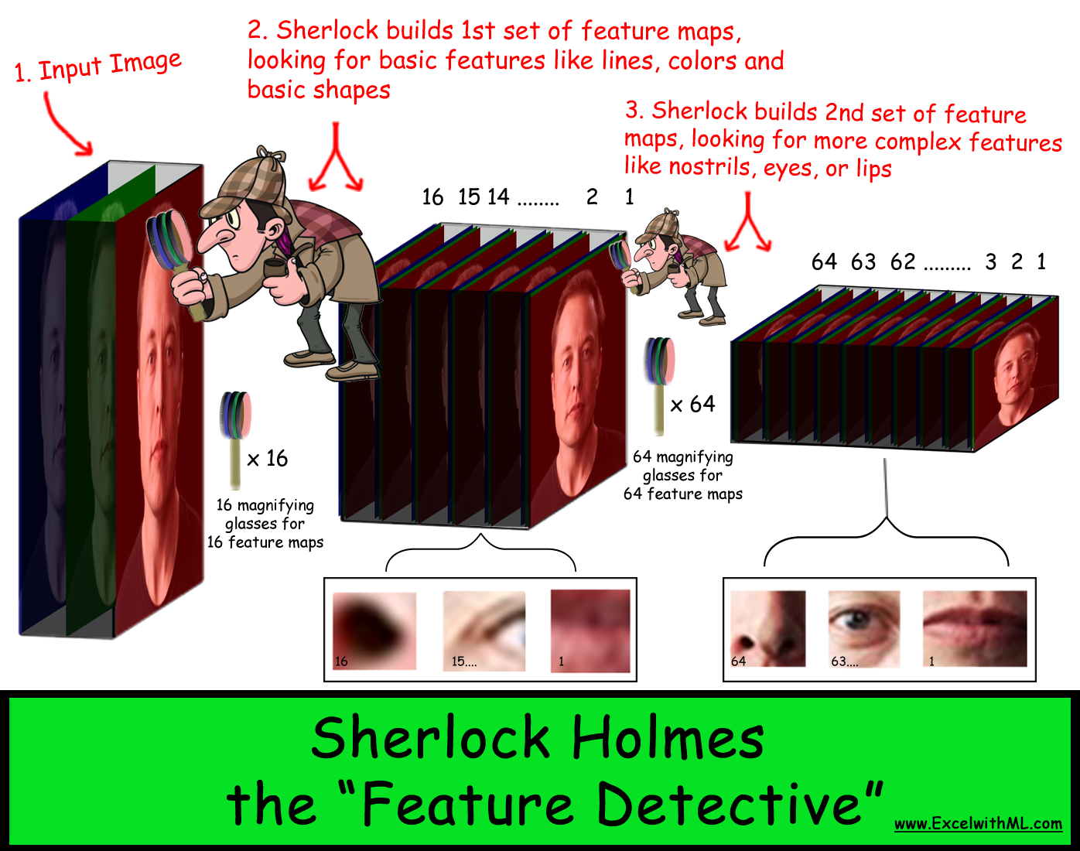

Slide 32
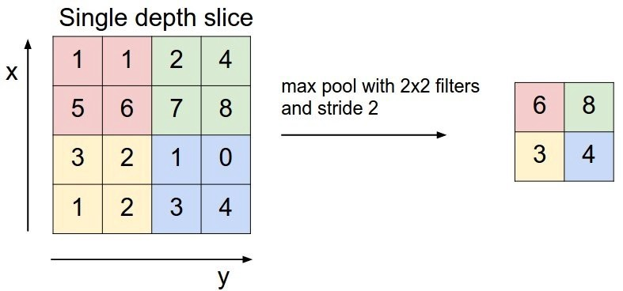
Max Pooling
Notes:
https://hackernoon.com/deep-learning-cnns-in-tensorflow-with-gpus-cba6efe0acc2

Slide 33

Convolution
Notes:
https://hackernoon.com/deep-learning-cnns-in-tensorflow-with-gpus-cba6efe0acc2

Slide 34
What the Model “Sees”

Slide 35
Data Augmentation

Slide 36
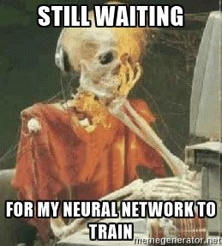
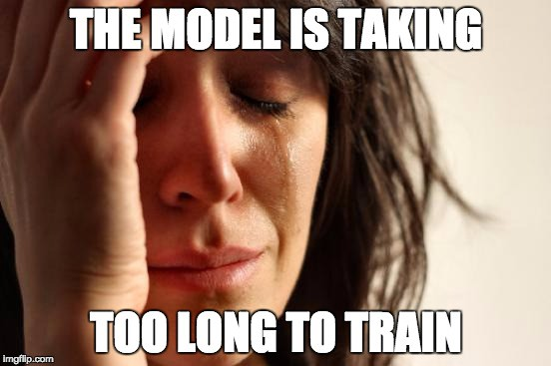
Patience is Key

Slide 37
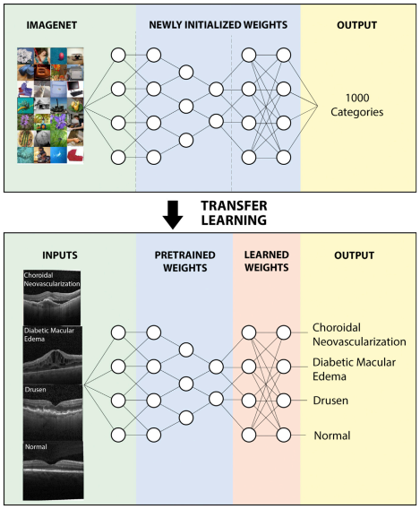
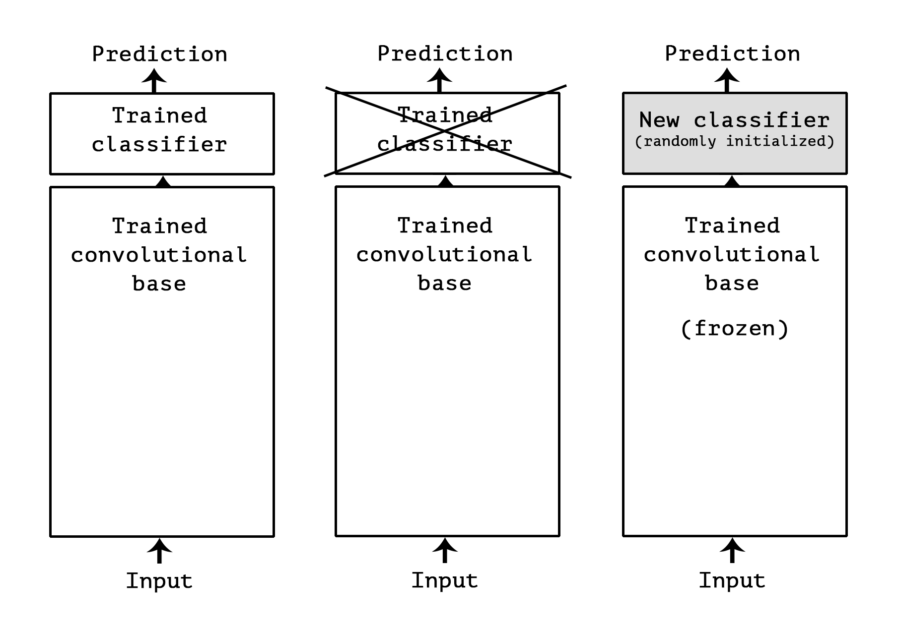
Pre-Trained Networks

Slide 38
Heatmaps of Activation Layers

Slide 39
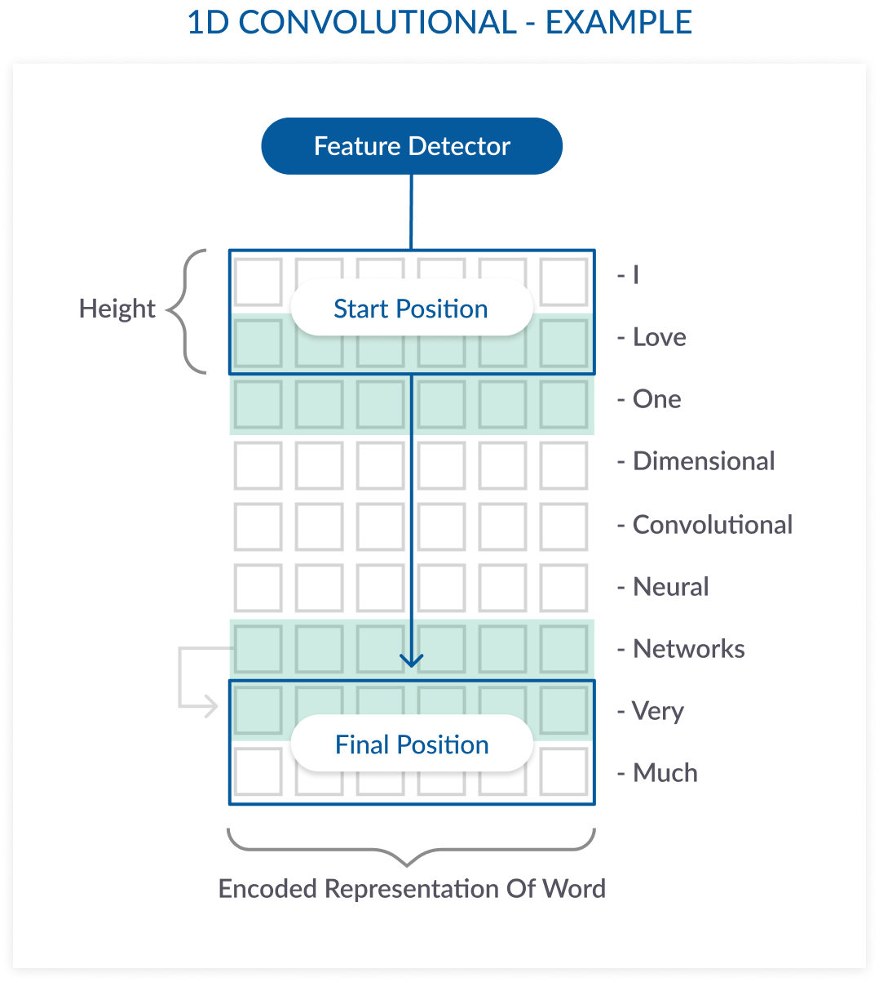
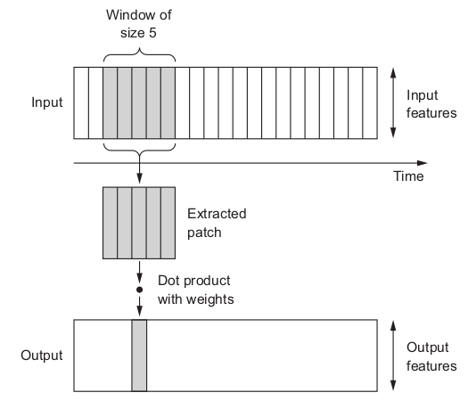
Convolution on Text

Slide 40
What Did I Not Cover?

Slide 41
MANY, MANY Topics
Recurrent Neural Network
Long Short-Term Memory (LSTM)
Object Detection
Generative Adversarial Network
Many other things….
This field is evolving every day!

Slide 42
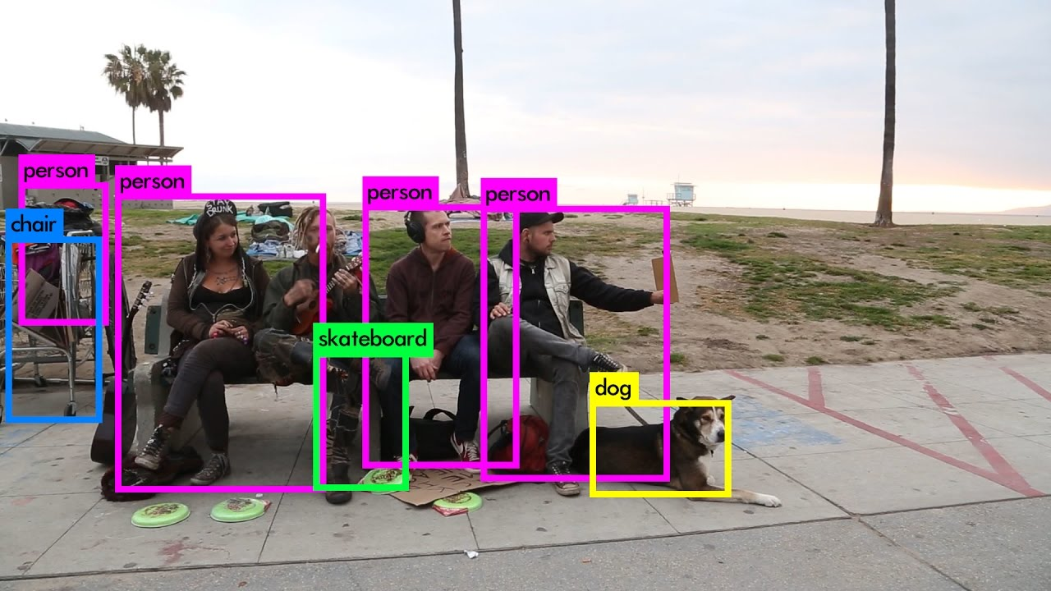
YOLO: You Only Look Once
https://pjreddie.com/darknet/yolo/

Slide 43
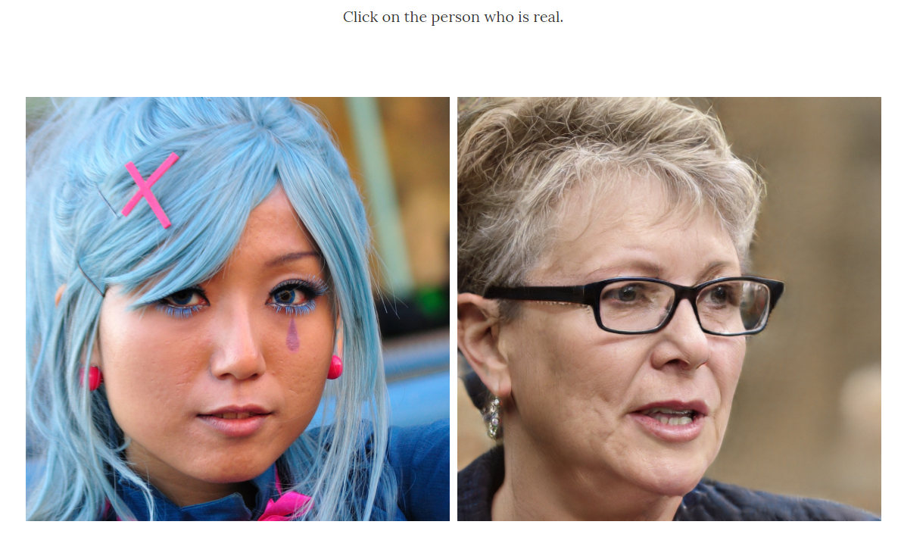
http://www.whichfaceisreal.com/

Slide 44
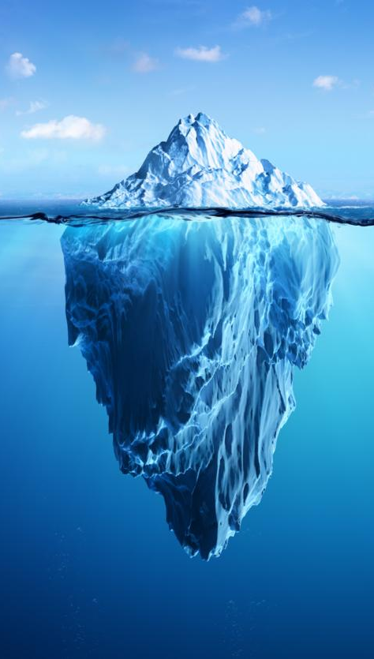
What Did We Cover
Supervised Learning on data, images, and text
Supervised Learning: End-to-End
Unsupervised Learning
Automated Machine Learning
Explainable Machine Learning
Deep Learning

Slide 45
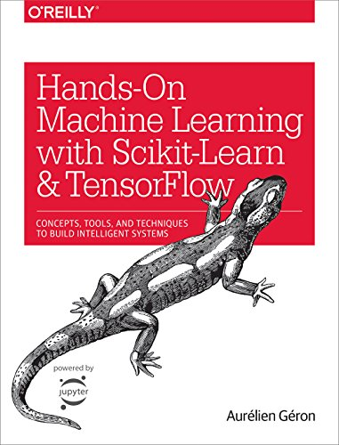
Book Give-Away

Slide 46
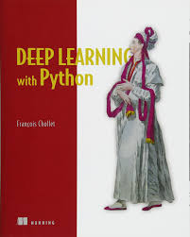
References
Deep Learning with Python, by F. Chollet
https://github.com/fchollet/deep-learning-with-python-notebooks
http://cs231n.github.io/convolutional-networks/

